Slide 1

Environment Setup
Tools we need

Slide 2
Main tools
Python
VScode

Slide 3
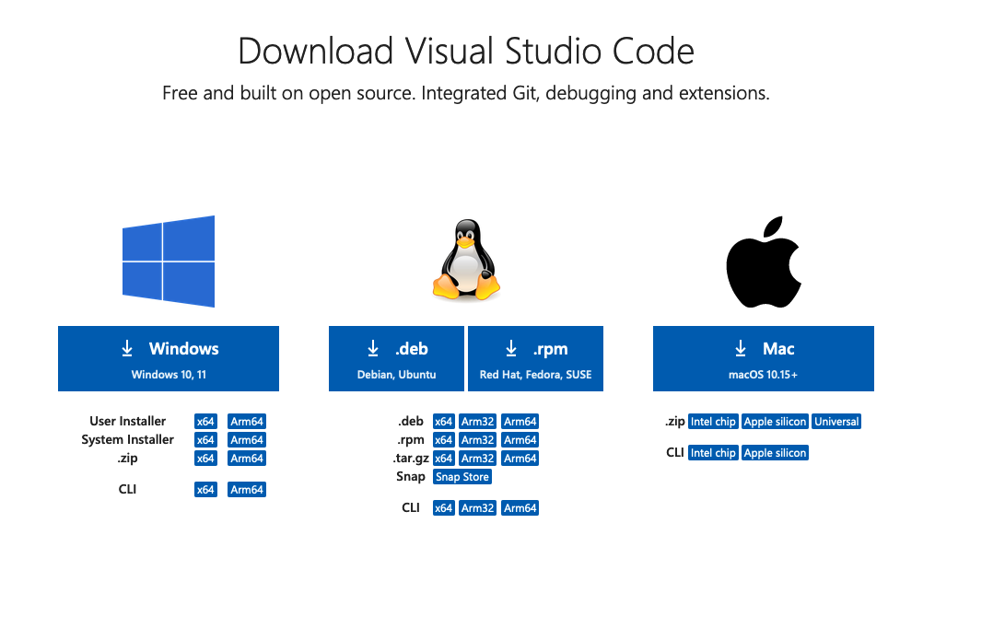
VScode Download
https://code.visualstudio.com/download

Slide 4
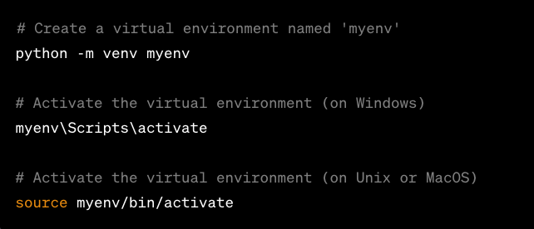
What is a virtual environment?
A virtual environment in Python is a self-contained directory that houses a specific Python interpreter and its associated libraries. It allows you to create isolated environments for different projects, preventing conflicts between dependencies and versions.

Slide 5
Why use a virtual environment
Isolation of Dependencies: Different projects may require different versions of libraries or even Python itself. Virtual environments ensure that each project has its isolated space, preventing conflicts between dependencies.
Version Compatibility: Virtual environments allow you to specify and control the version of Python for your project. This is particularly important when dealing with legacy code or libraries that may not be compatible with the latest Python version.
Easy Dependency Management: With a virtual environment, you can install, upgrade, and uninstall libraries without affecting the system-wide Python installation. This makes it easier to manage project-specific dependencies.
Cleaner Development Environment: Virtual environments keep your development environment clean by avoiding the clutter of installed packages that are not needed for a particular project.
Reproducibility: Virtual environments enhance the reproducibility of your projects. By specifying the exact versions of the dependencies in a requirements.txt file, you can recreate the same environment on another machine.

Slide 6
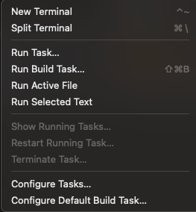
Open Terminal
Open VScode in new window
In the upper banner menu:
Terminal -> New Terminal

Slide 7
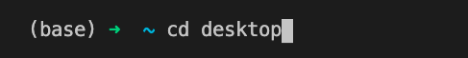

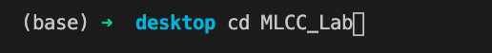
Directory creation and navigation
Navigate from root to desktop
Make a directory (new folder)
Navigate to MLCC_Lab

Slide 8



Create first project!
Create project directory
Navigate to project_1
Start your first project!

Slide 9




Create your Virtual Environment (VENV)
Windows
Create and name VENV
Activate the VENV
Mac/Linux
Create and name VENV
Activate the VENV

Slide 10
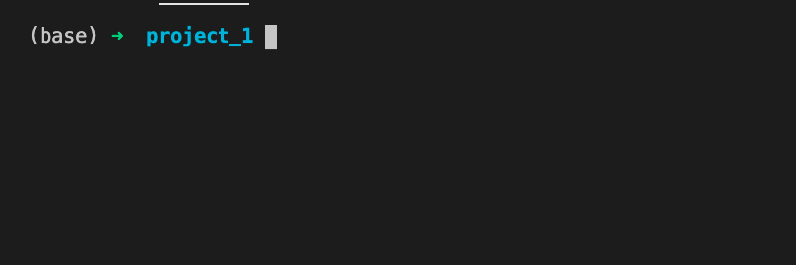
Terminal should go from this:

Slide 11
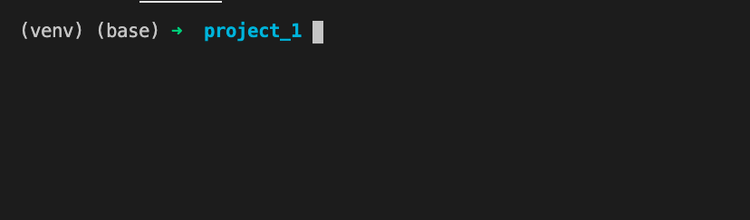
To this:

Slide 12
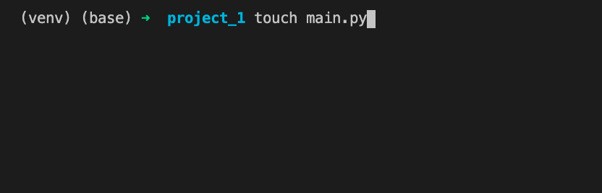
Start your python Project!

Slide 13
Linear Regression with Machine Learning!
How do we do it?
Have a question.
Find a CSV.
Ask ChatGPT.

Slide 14
Understanding the question
What is the expected salary based on years of experience?
Index | YearsExperience | Salary
0 | 1.2000000000000002 | 39344.0
1 | 1.4000000000000001 | 46206.0

Slide 15
CSV File
You can find plenty on Kaggle
Today we will be working with this file: here Please download the file.

Slide 16
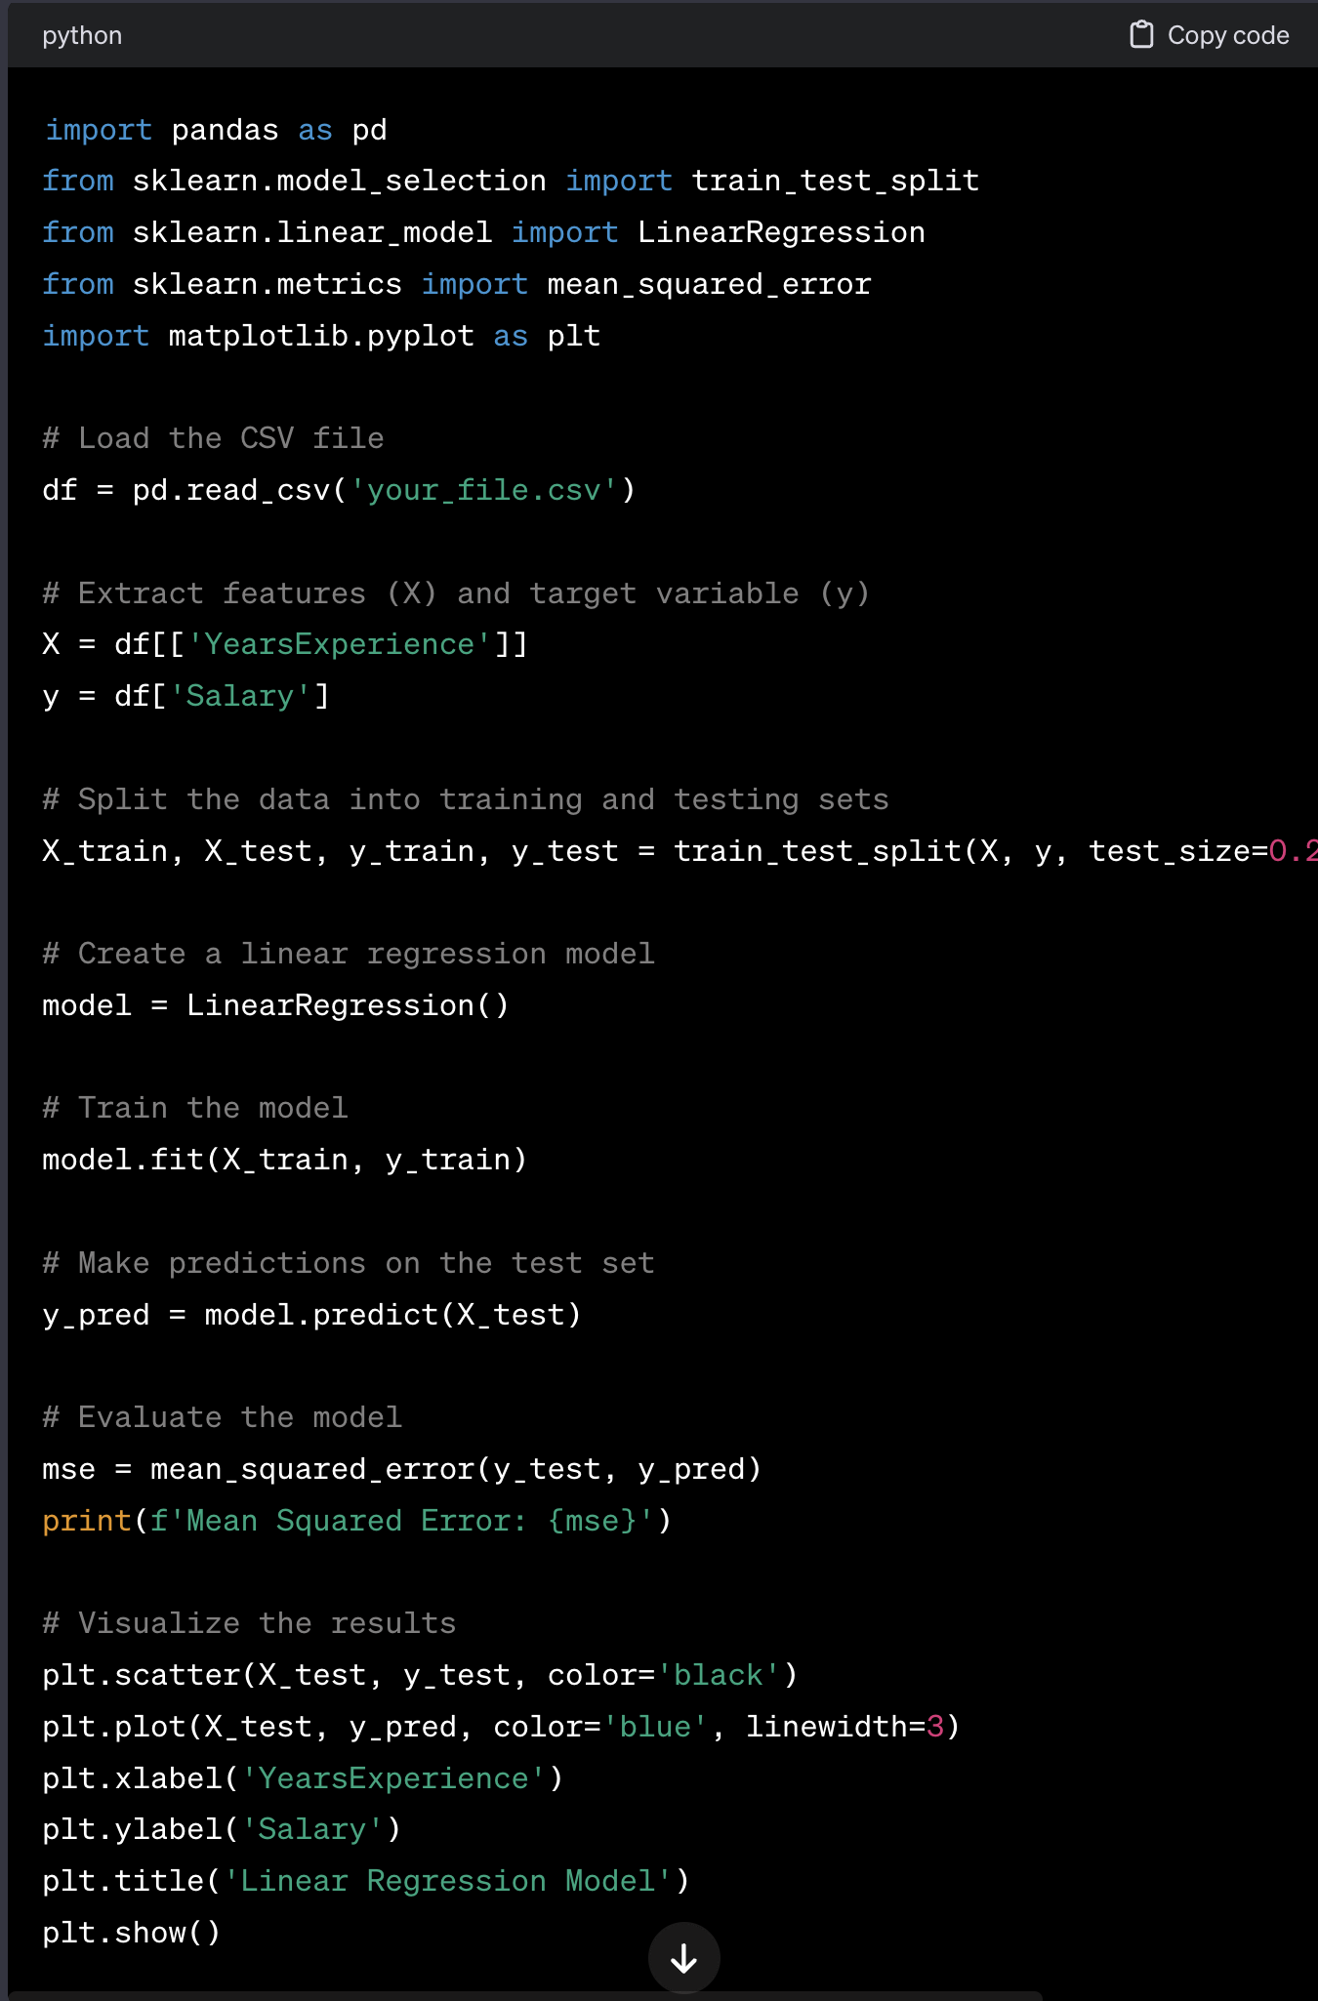
Ask Chat GPT
“Write me some python machine learning code for a linear regression model based off these columns of a CSV file.
Index,YearsExperience,Salary”
You should get something like this

Slide 17
Install dependencies.
Inside the terminal:
pip install pandas
pip install -U scikit-learn
pip install matplotlib
Inside the code
Direct file path to your csv file: ‘Salary_dataset.csv”
Try and run the program.

Slide 18
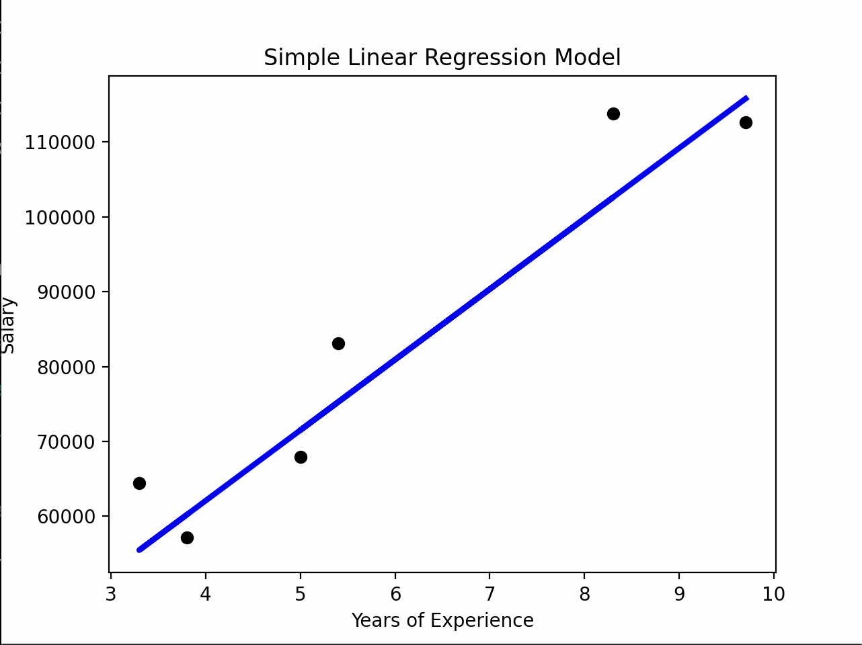
We should get something like this.

Slide 19
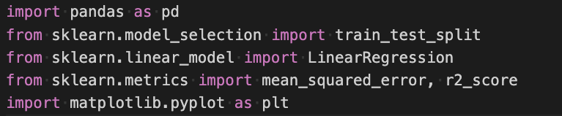
But what does it mean?
Using Pandas:
Import Libraries
Train_test_split from
Scikit-learn:
Linear Regression from
Scikit-learn:
Metrics from Scikit-learn:
Matplotlib for charts and plotting:

Slide 20
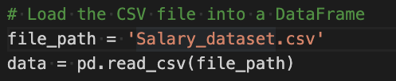
Load CSV file into Data Frame
File path to CSV
Convert CSV to DataFrame

Slide 21

Identify Variables
X is set as to extract the data from the ‘YearsExperience’ column of the CSV.
y is set to the ‘Salary’ column.

Slide 22
Train, test, split
This line splits our data for each of our variables into a training group, and a testing group. The test group size is dictated by the test_size, currently set to 0.2 which represents 20% of our data
X
y
100
Train
Train
% of data
Test
Test
0

Slide 23
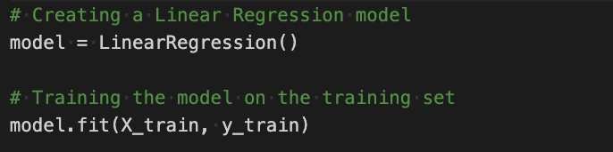
Instantiating the model and train

Slide 24
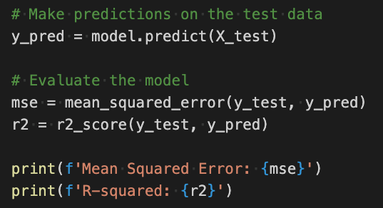

Test the model and evaluate
Predict y values based on X_test
Evaluate the prediction data against the test data for y

Slide 25
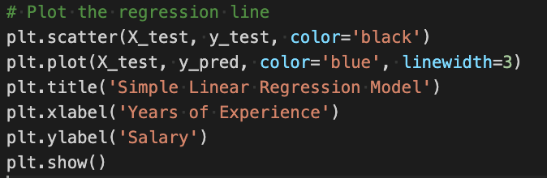
Plot your results

Slide 26
Predict a new salary!
New value for X new_experience is set to user input for a data type ‘float’
Predict value of y based on the linear regression model

